Slide 1
MLA 8th Edition
Reminders, Updates, and Helpful Tools

Slide 2
MLA REMINDERS

Slide 3
Goal: Make your documentation useful to the reader
Good writers understand why they create citations.
-Demonstrating thoroughness of research
-Giving credit to original sources
-Ensuring readers can find the sources consulted
To achieve this goal, the documentation should provide sufficient information in a consistent structure.
Notes:
Understanding why you cite sources may help you realize just how important using quality sources is.

Slide 4
Using EasyBib/Databases to cite sources:
EasyBib and the database citations are TOOLS for helping you create and organize your works cited lists.
It is YOUR job (with help!) to verify that everything you need is there & accurate!

Slide 5
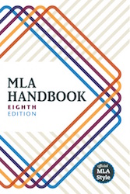
MLA = Modern Language Association
MLA is one of several accepted styles for writing papers and creating works cited lists. MLA is the standard style for high school research.
The new handbook “really focuses on principles -- not just on how to create a citation that is correct, but on the purposes of citation practice, as well as on strategies for evaluating sources”(Flaherty).
Notes:
I know you’ve already learned the MLA paper formatting rules. This lesson show you how to begin creating an MLA jWorks Cited list for the sources you use when writing papers.

Slide 6
MLA 8: NEW TEMPLATE

Slide 7
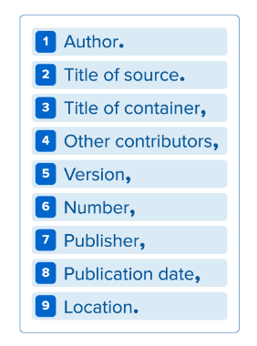
What’s in your citations-
When deciding how to cite your source, start by consulting the list of core elements. In your citation, the elements should be listed in the following order:
Each element should be followed by the punctuation mark shown here (just commas and periods separate the elements).
Notes:
Important elements in a work cited list.

Slide 8
MLA 8: ELEMENTS OF A CITATION

Slide 9
Author:
Begin the entry with the author’s last name, followed by a comma and the rest of the name, as presented in the work. End this element with a period.
Said, Edward W. Culture and Imperialism. Knopf, 1994.
TWO AUTHORS: Smith, John, and Nancy Phillips.
THREE OR MORE AUTHORS: Smith, John, et al.

Slide 10
Title of Source:
The title of the source should follow the author’s name. Depending upon the type of source, it should be listed in italics or quotation marks.
A book should be in italics:
Henley, Patricia. The Hummingbird House. MacMurray, 1999.
A website or database should be in italics:
Lundman, Susan. "How to Make Vegetarian Chili."eHow, www.ehow.com/how_10727_make-vegetarian-chili.html.

Slide 11
Title of Source:
A periodical (journal, magazine, newspaper article) should be in quotation marks:
Bagchi, Alaknanda. "Conflicting Nationalisms: The Voice of the Subaltern in Mahasweta Devi's Bashai Tudu." Tulsa Studies in Women's Literature, vol. 15, no. 1, 1996, pp. 41-50.

Slide 12
NEW CONCEPT: Containers
Containers are the larger entity in which the source is located. The title of the container is usually italicized and followed by a comma, since the information that follows next describes the container.
EXAMPLES
A poetry collection (individual poem)
A TV series (individual episodes)
A website (articles, postings, other works)

Slide 13
New Concept: Containers Within Containers
In some cases, a container might be within a larger container. It is important to cite these containers within containers so that your readers can find the exact source that you used.
EXAMPLES
Read a book of short stories on Google Books
Watched a television series on Netflix
Electronic version of a journal on the Gale databases

Slide 14
Works Cited Page with Containers Hilighted (also note: ABC order by first part of the entry)
“94 Meetings.” Parks and Recreation, created by Greg Daniels and Michael Schur, performance by Amy
Poehler, season 2, episode 21, Deedle-Dee Productions and Universal Media Studios, 2010.
“94 Meetings.” Parks and Recreation, season 2, episode 21, NBC, 29 Apr. 2010. Netflix,
www.netflix.com/watch/70152031?trackId=200256157&tctx=0%2C20%2C0974d361-27cd-44de- 9c2a-2d9d868b9f64-12120962.
Kincaid, Jamaica. "Girl." The Vintage Book of Contemporary American Short Stories, edited by Tobias
Wolff, Vintage, 1994, pp. 306-07.
Langhamer, Claire. “Love and Courtship in Mid-Twentieth-Century England.” Historical Journal, vol. 50, no. 1, 2007, pp. 173-96. ProQuest, doi:10.1017/S0018246X06005966. Accessed 27 May 2009.
Zinkievich, Craig. Interview by Gareth Von Kallenbach. Skewed & Reviewed, 27 Apr. 2009, www.arcgames.com/en/games/star-trek-online/news/detail/1056940-skewed-%2526-reviewed-
interviews-craig. Accessed 15 Mar. 2009.

Slide 15
Other Elements:
Other Contributors: Are there any editors, actors, directors, etc?
Version/number: Are there any volume or issue numbers?
Publisher: Which company or group published the information in print or electronically?
Publication date: If possible, include the day, month, and year (9 Dec. 2015). There must be a year listed or you can not use the source.
Location: Are there any page numbers or a URL? Is there a date that you accessed your online information?

Slide 16
Book Sources: MLA 8

Slide 17
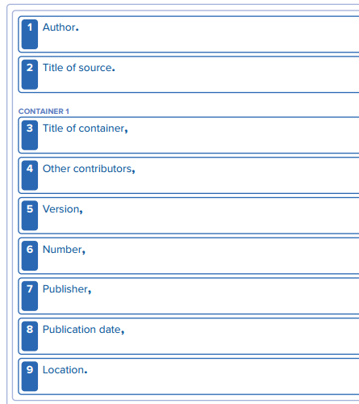
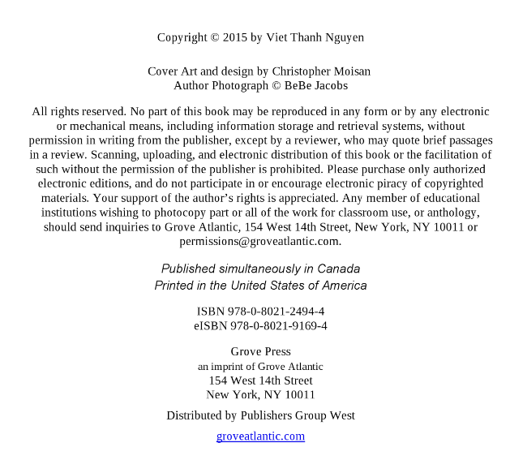
Pub date #8
Nguyen, Viet Thanh.
The Sympathizer.
Title #2
#1 Author
Grove Press,
2015.
#7 Publisher
Notes:
What do you notice about the author’s name in the form? Why do you think so few of the elements are filled in?

Slide 18
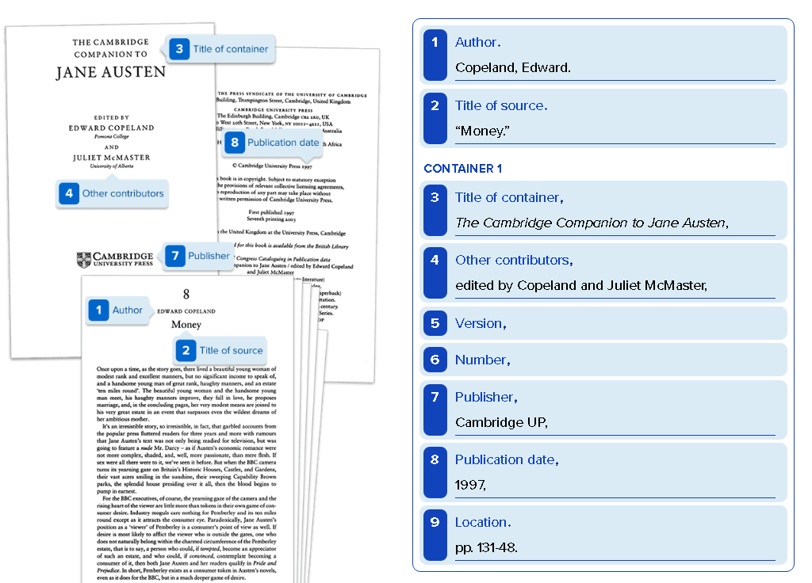
Notes:
What do you notice about the Author’s name? What about the Two titles?

Slide 19
Database Sources: MLA 8

Slide 20
Database Articles: MLA 7 vs. 8
Example
The differences in citing an article from a scholarly journal:
7th edition:
Kinkaid, Jamaica. “In History.” Callaloo 24.2 (Spring 2001): 620-26. Web.
--------------------------------------------------------------------------------------------------------------------
8th edition:
Kincaid, Jamaica. “In History.” Callaloo, vol. 24, no. 2, Spring 2001, pp. 620-26, URL.
Accessed 1 June 2015.

Slide 21
Sample Works Cited Page

Slide 22
